Slide 1
Term Project
By: Jacob Wilkin, Celine Ogero, Logan Skidmore, Ishaan Patel

Slide 2
Project Description
This Adoption center database system shows the components and process of pet adoption. This database system manages adopter information, pet information, adoption transactions, employee details, and different adoption center information.

Slide 3
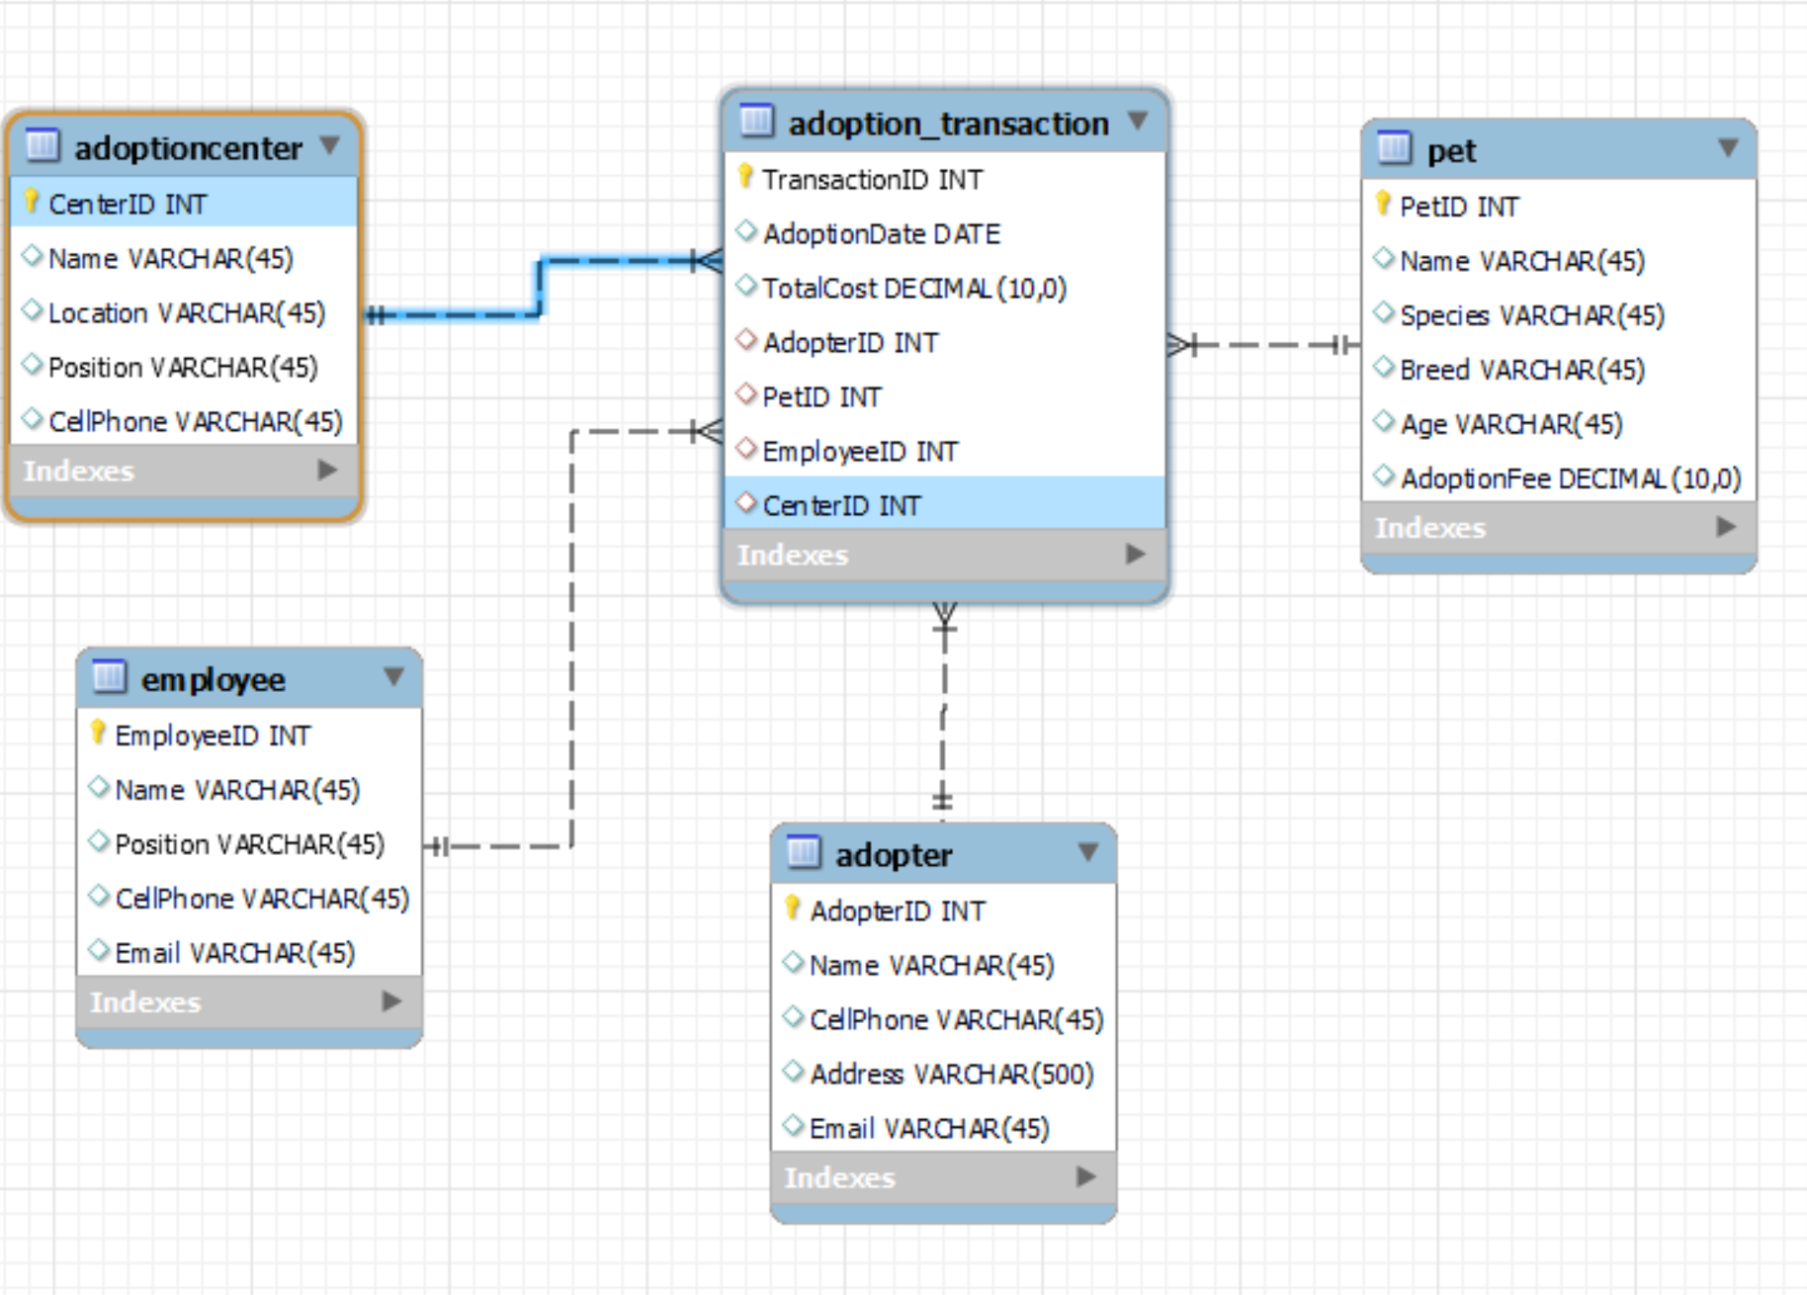
ERD Before Normalization

Slide 4
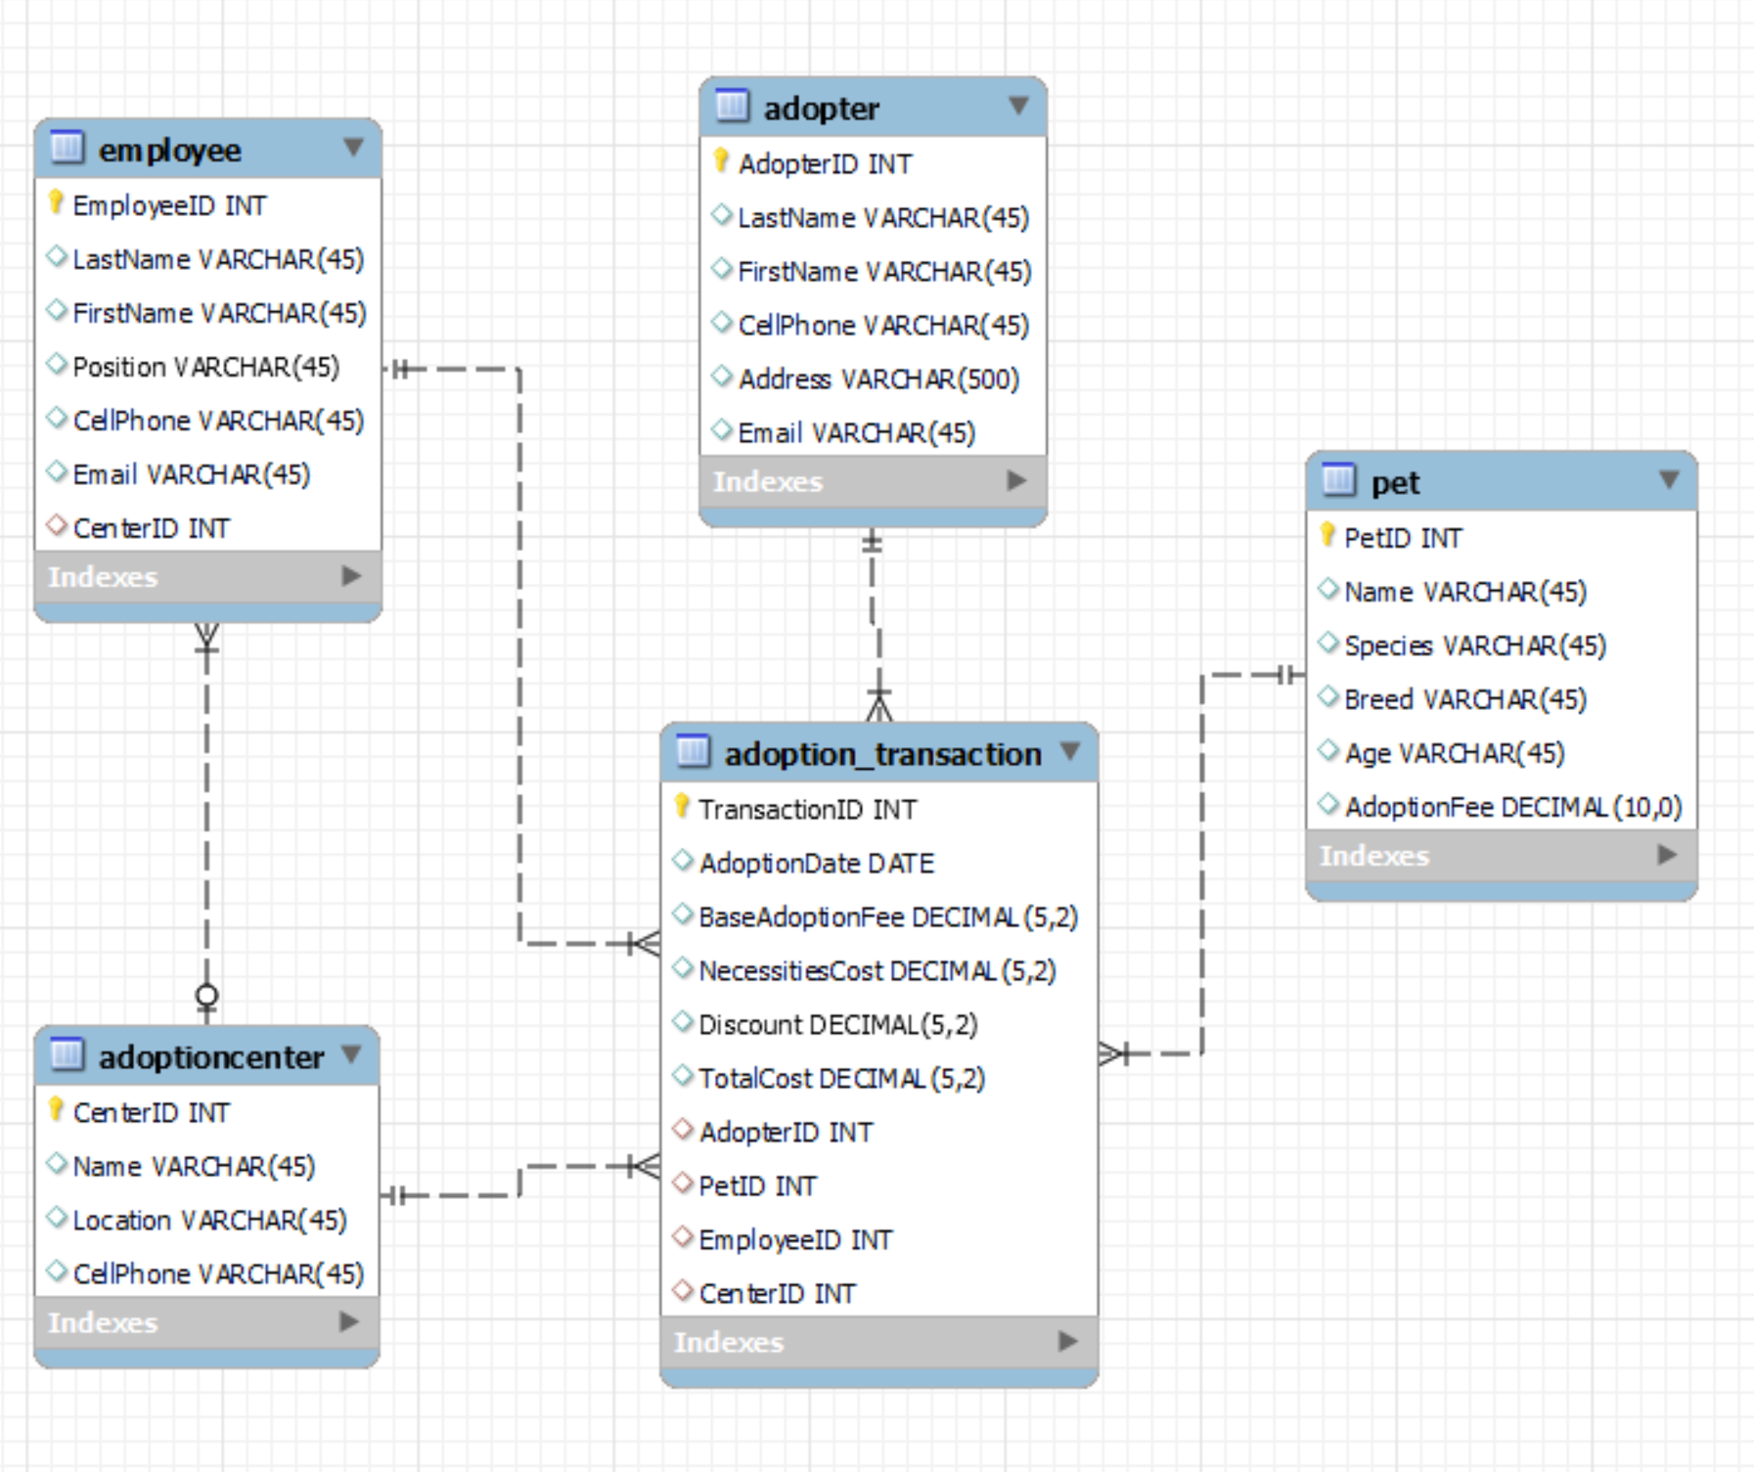
ERD After Normalization

Slide 5
Assumptions:
Assumptions:
This design assumes that a pet can go through multiple adoption transactions over time. This allows for returning the pet and the pet to be adopted again.
This design assumes that the fees for the pets are fixed.
Though prices may vary depending on if the adopter has a discount or not.

Slide 6
Limitations
Limitations:
This design doesn’t include a changelog.
No user authentication or authorization within this database.

Slide 7
Cardinality Relationships
An Adopter can have multiple Transactions (One to Many)
A Pet can be apart of multiple Transactions (One to Many)
An Employee is able to file multiple Transactions (One to Many)
Multiple Transactions take place inside one Adoption Center (Many to One)
Multiple Employees can work at a single Adoption Center (Many to one)

Slide 8
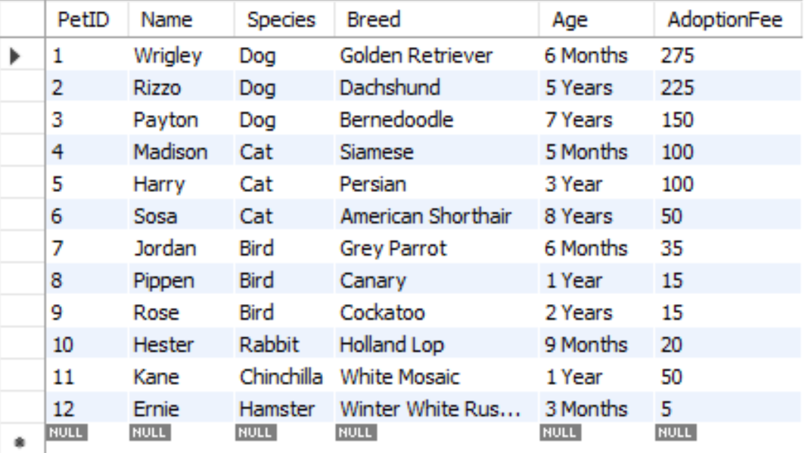
Table Pet

Slide 9
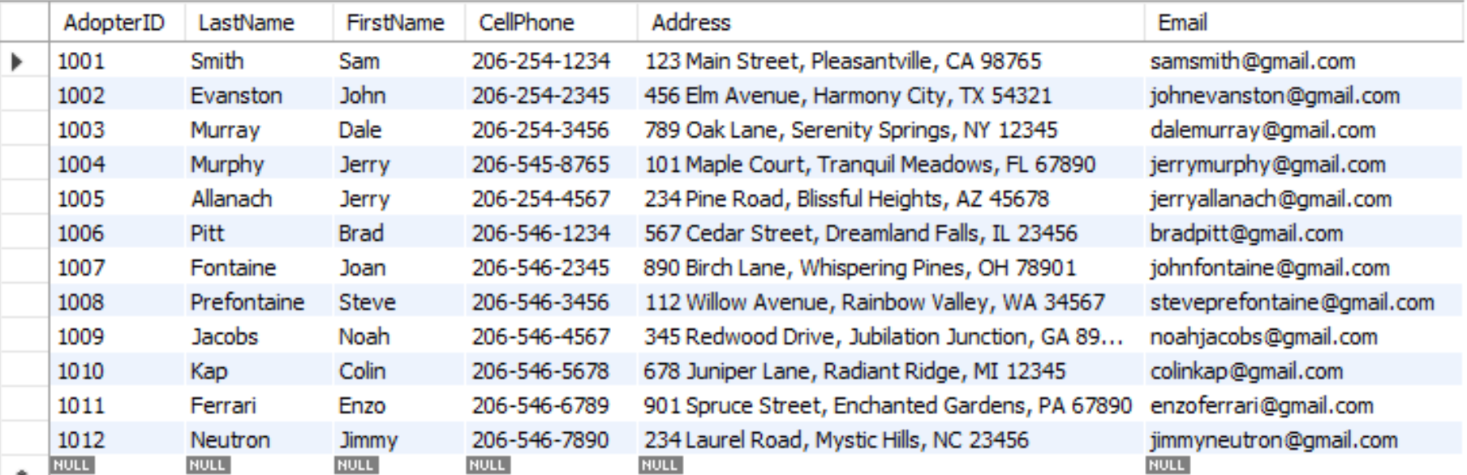
Table Adopter

Slide 10
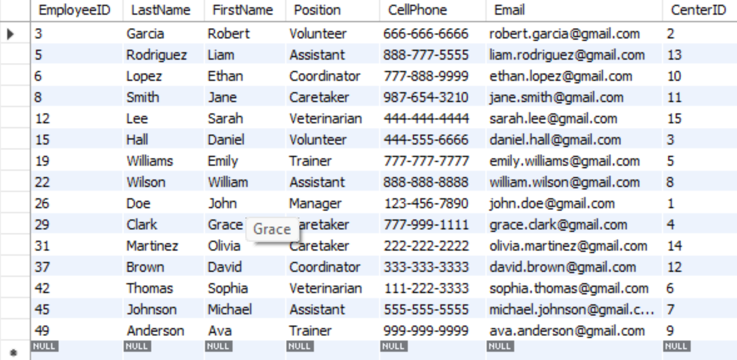
Table Employee

Slide 11
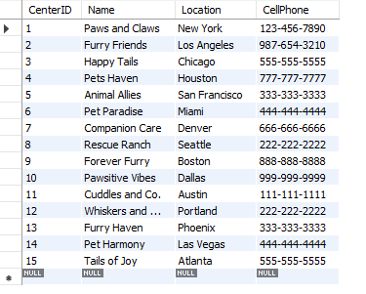
Table Adoption Center

Slide 12
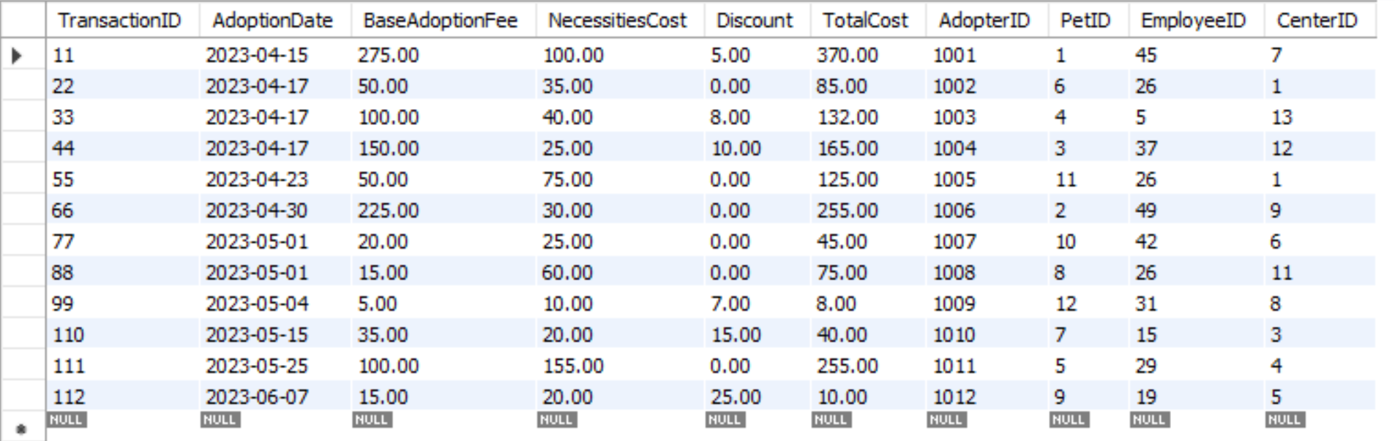
Table Adoption Transaction

Slide 13
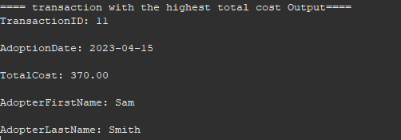
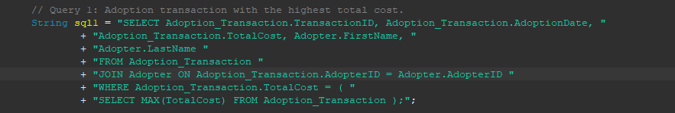
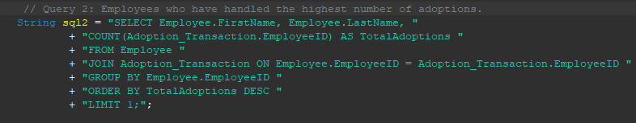
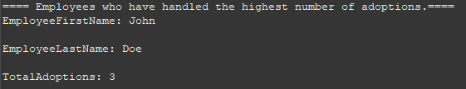
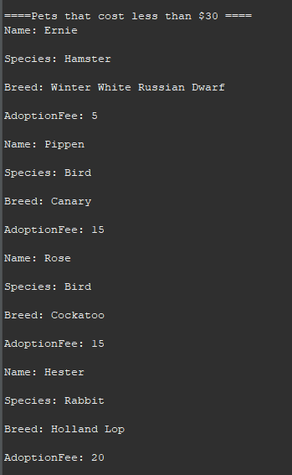
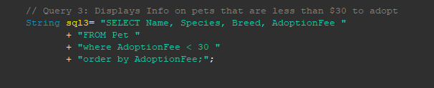
Queries (Logan)

Slide 14

Queries (Ishaan)

Slide 15
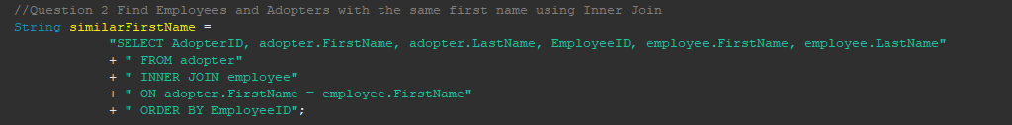
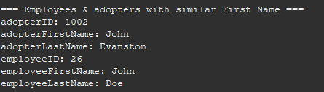
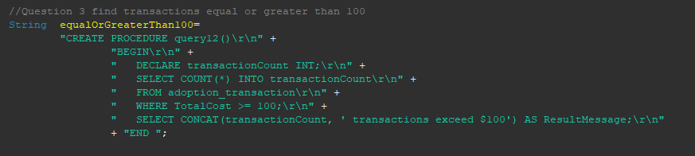

Queries (Ishaan) Cont.

Slide 16
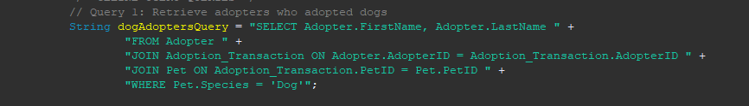
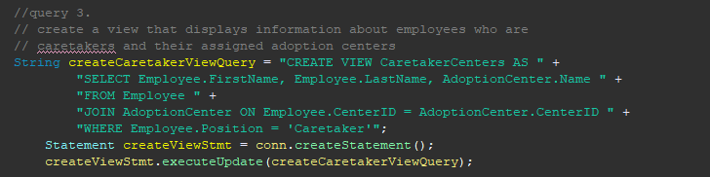
Queries (Celine)

Slide 17
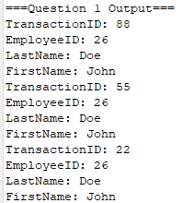
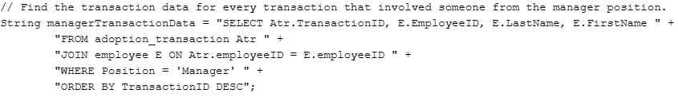
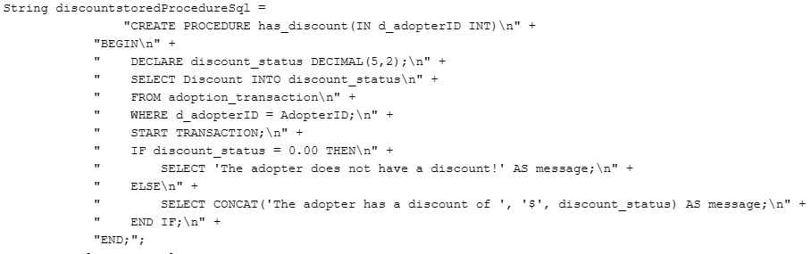
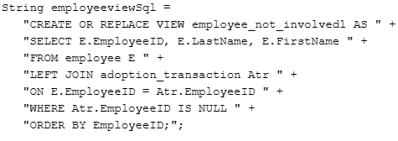
Queries(Jacob)

